Slide 1
BUILDOTS UPDATE : 30/01/2020

Slide 2
SUMMARY
Stabilization for 5K and 5.7K recordings using Garmin VIRB Edit app
Multi-room test
5 FPS test

Slide 3
STABILIZATION TESTS
Connecting the camera directly to the Garmin VIRB edit software
Garmin VIRB stabilization only available if G-metrix available.
Tests at 10FPS for the Colmap spherical camera models
Single room
Caution: Garmin VIRB edit has stitched back and front camera in order to stabilize the frames. Need to take this in account.

Slide 4
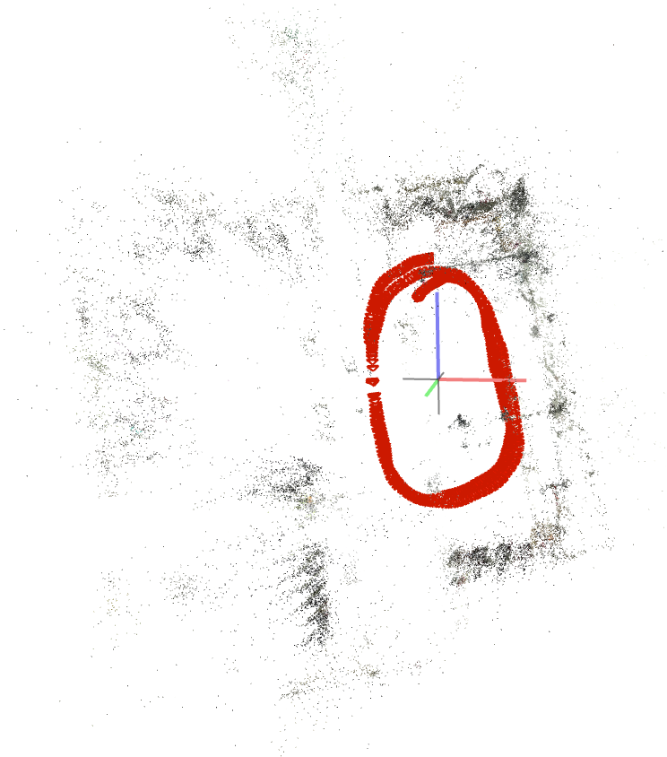
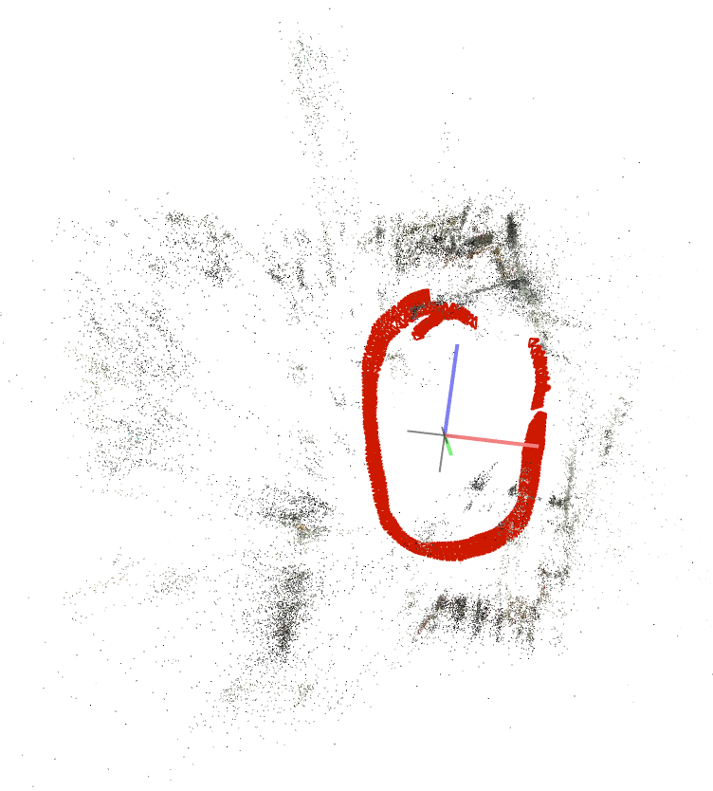
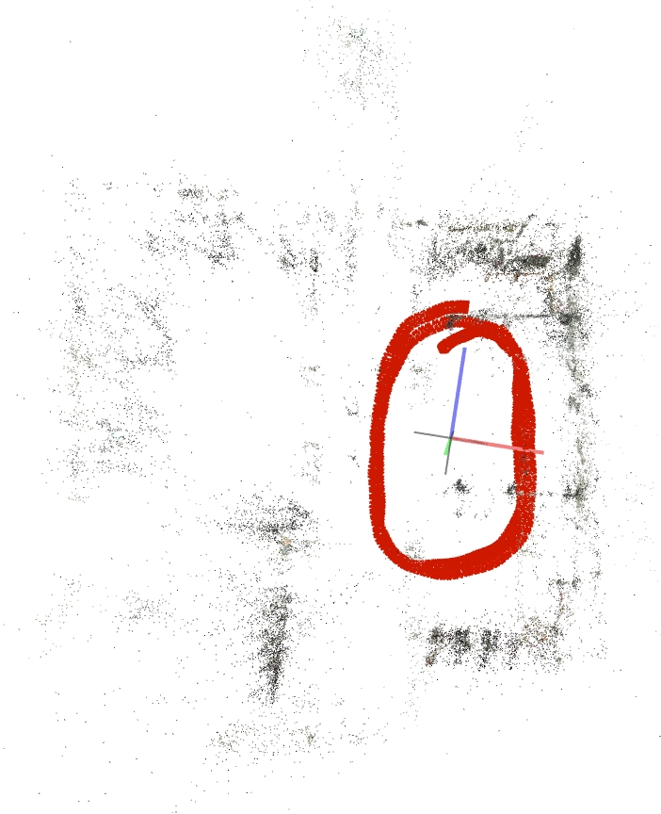
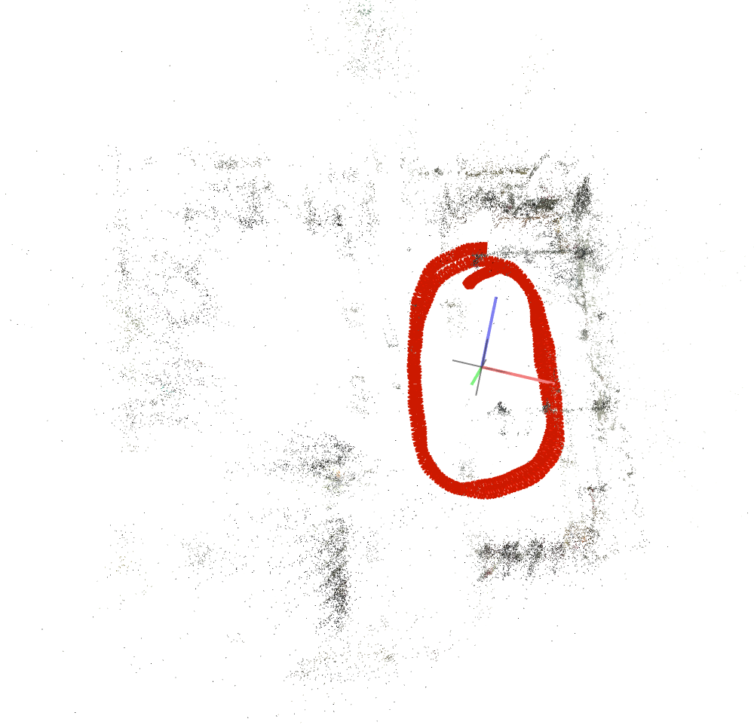
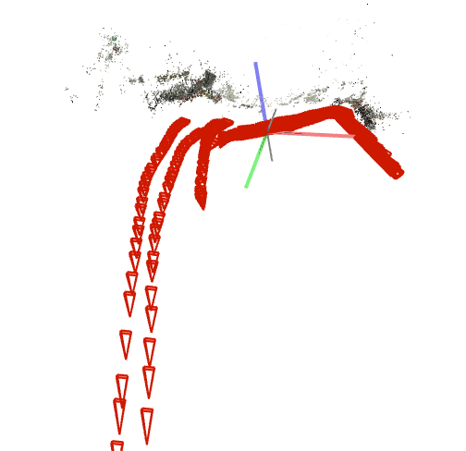
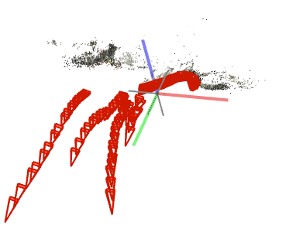
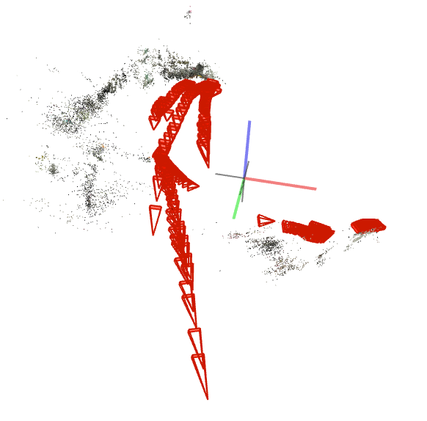
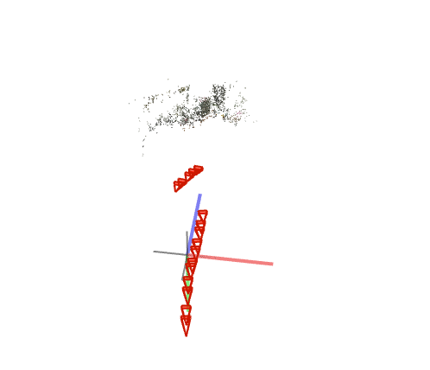
10 FPS 5K
SIMPLE_RADIAL_FISHEYE | SIMPLE_RADIAL | RADIAL | FOV
STABILIZED

Slide 5
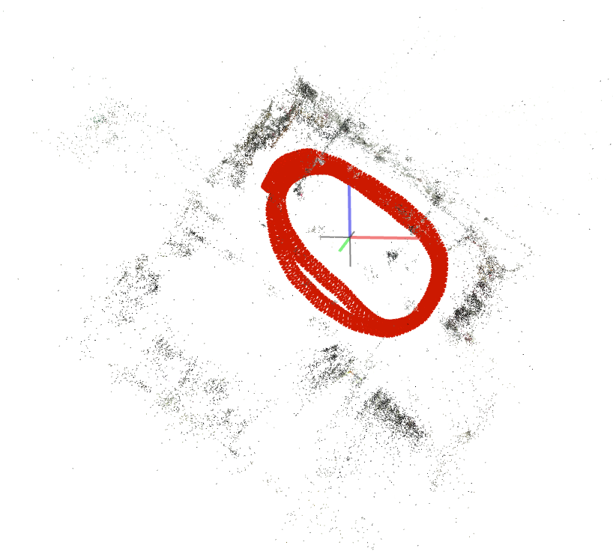
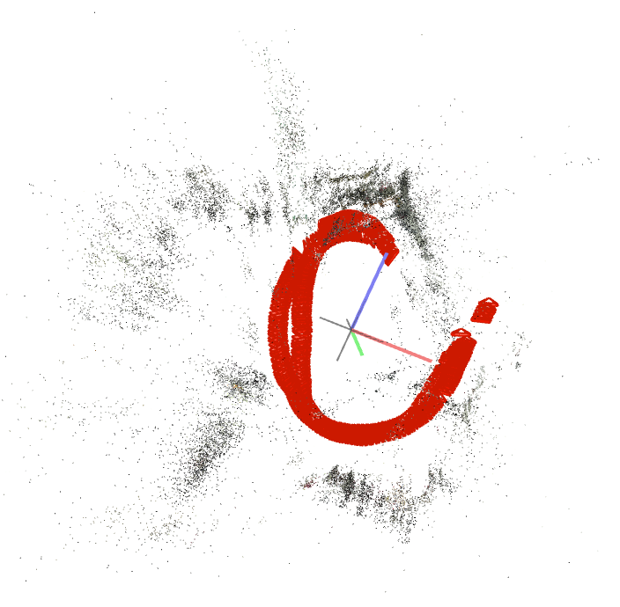
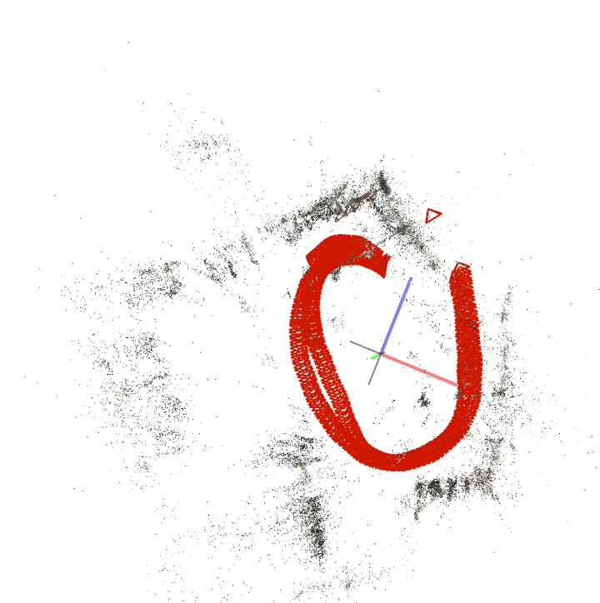
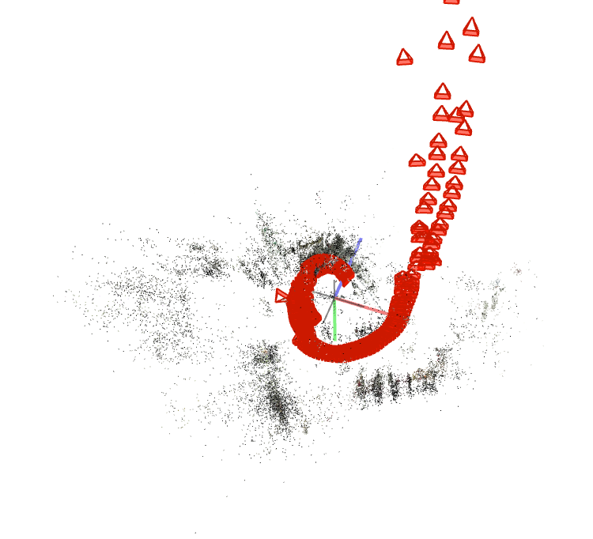
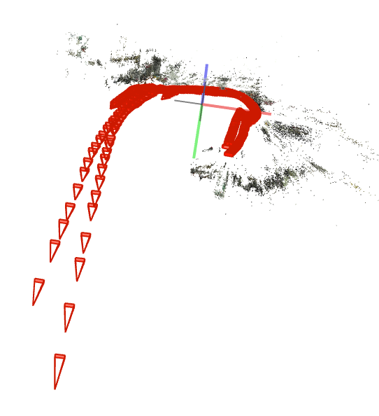
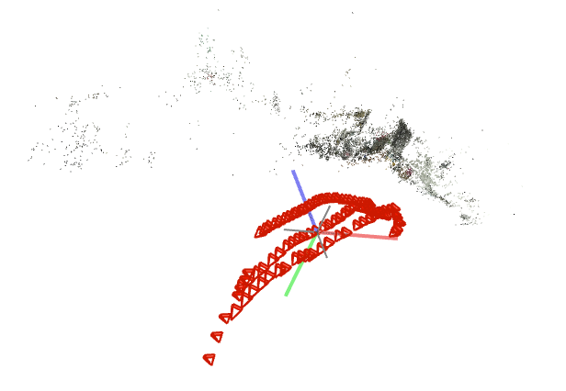
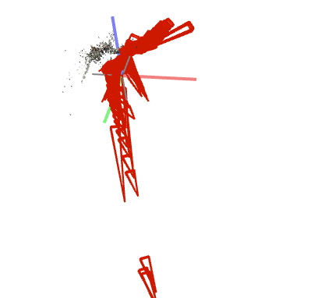
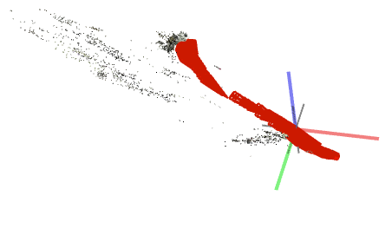
10 FPS 5.7K
SIMPLE_RADIAL_FISHEYE | SIMPLE_RADIAL | RADIAL | FOV
STABILIZED

Slide 6
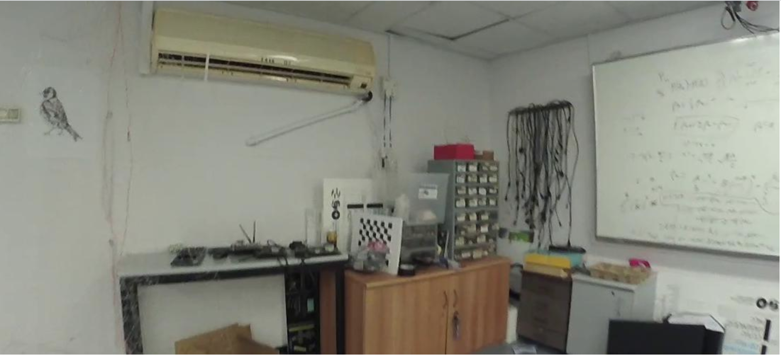
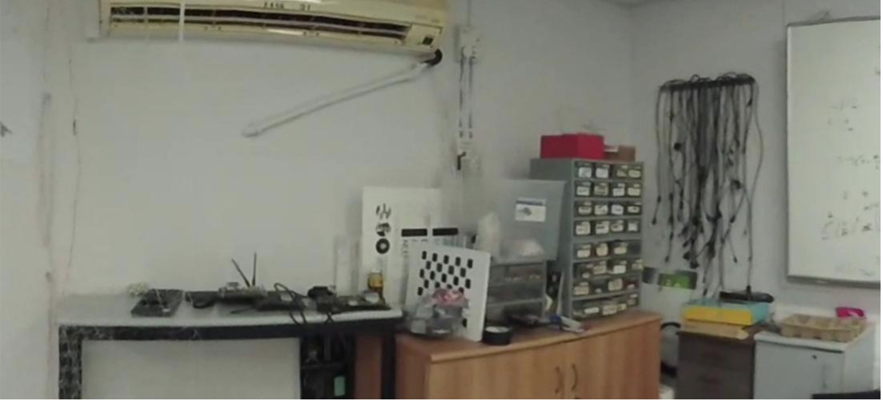
POSSIBLE REASON FOR FAILURE
Unstabilized
stabilized
Experiment failed due to less details within the new frame frame, ‘zoom’ effect.
(Notice that each of the camera models have output between 6 and 14 sparse models, emphasizing the lack of features in order to understand that the recorded room was one single volume entity).

Slide 7
CORRECTION : INCREASE FRAME SIZE
Stabilization with Garmin VIRB edit app only possible after stitching back and front camera => need to take in account for the stitching to ‘zoom’ in the frame.
5K crop center from 1100x500 to 1400x650
5.7K crop center from 1400x650 to 1600x800

Slide 8
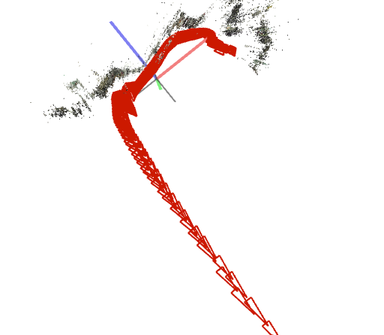
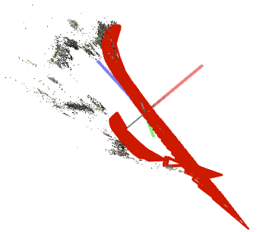
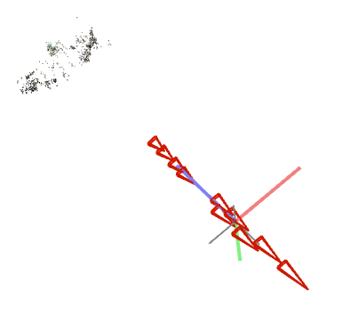
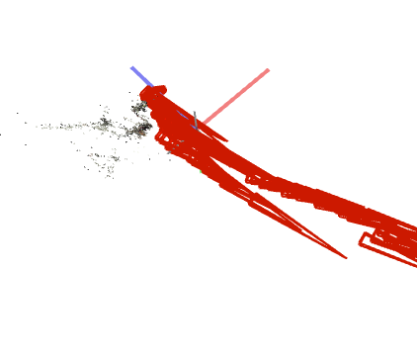
CORRECTION : 10 FPS 5K
SIMPLE_RADIAL_FISHEYE | SIMPLE_RADIAL | RADIAL | FOV
STABILIZED

Slide 9
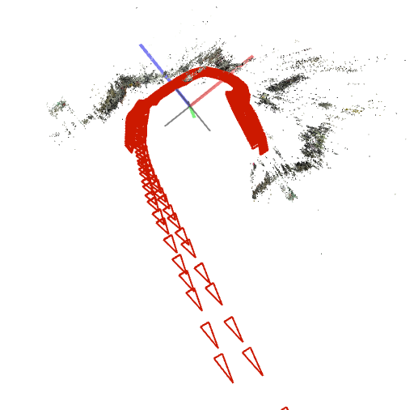
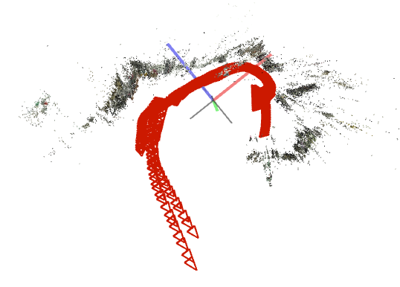
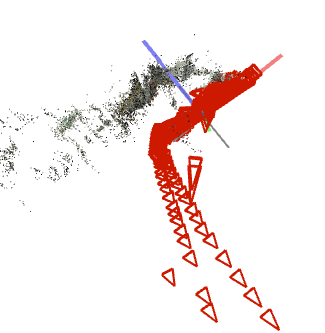
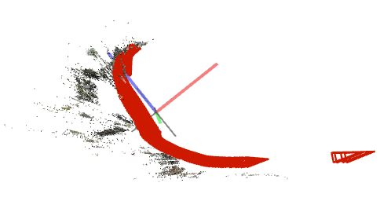
CORRECTION : 10 FPS 5.7K
SIMPLE_RADIAL_FISHEYE | SIMPLE_RADIAL | RADIAL | FOV
STABILIZED

Slide 10
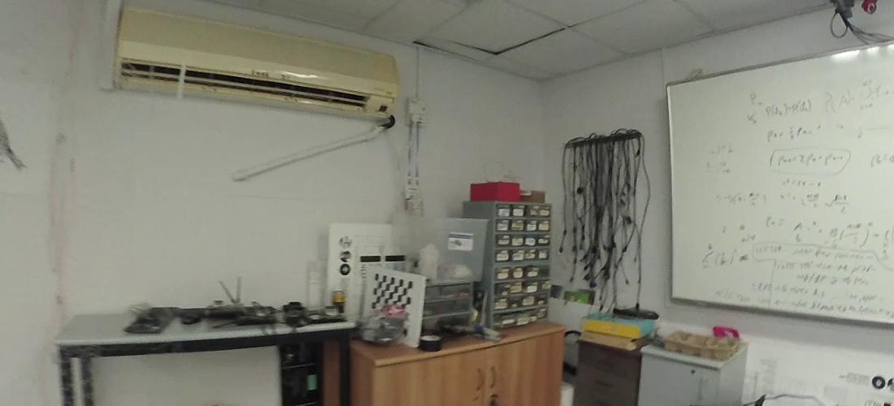
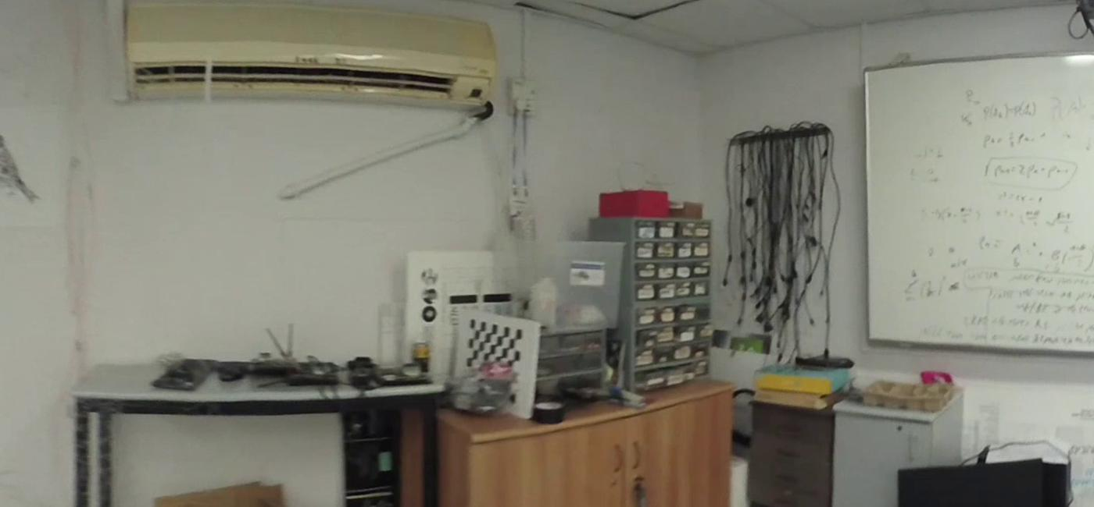


CONCLUSION
Stabilization with Garmin VIRB app seems to affect Colmap calibration.
Unstabilized
Stabilized
Must stabilize the video without Garmin VIRB edit in order to avoid the stitching distortion

Slide 11
MULTI-ROOM TEST
5K
10FPS
Colmap spherical camera models
Non stabilized video

Slide 12
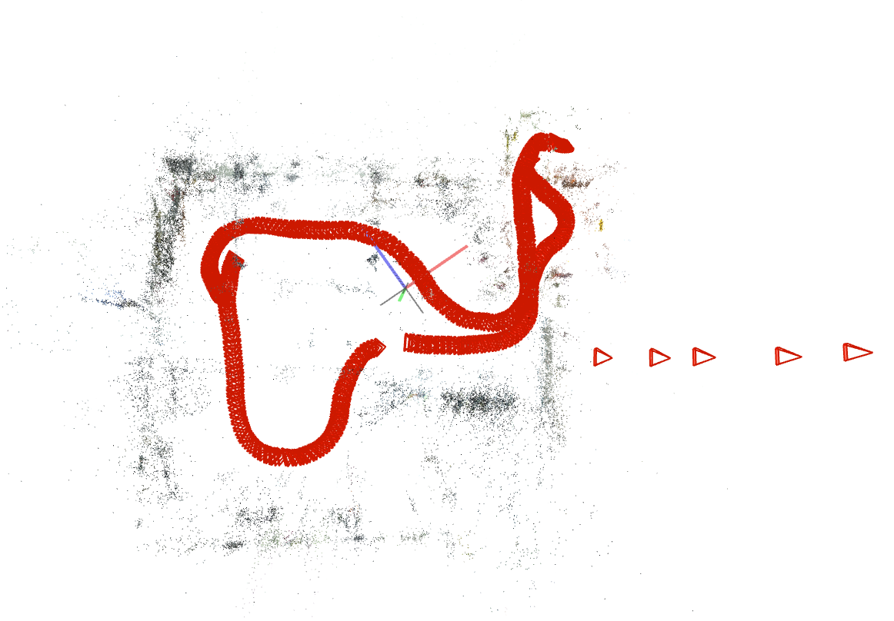
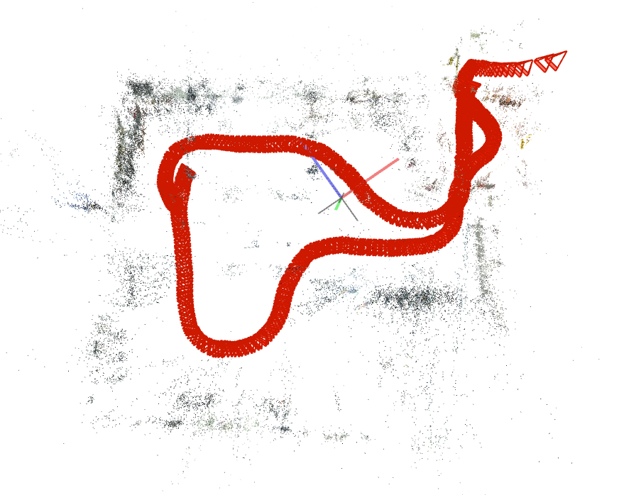
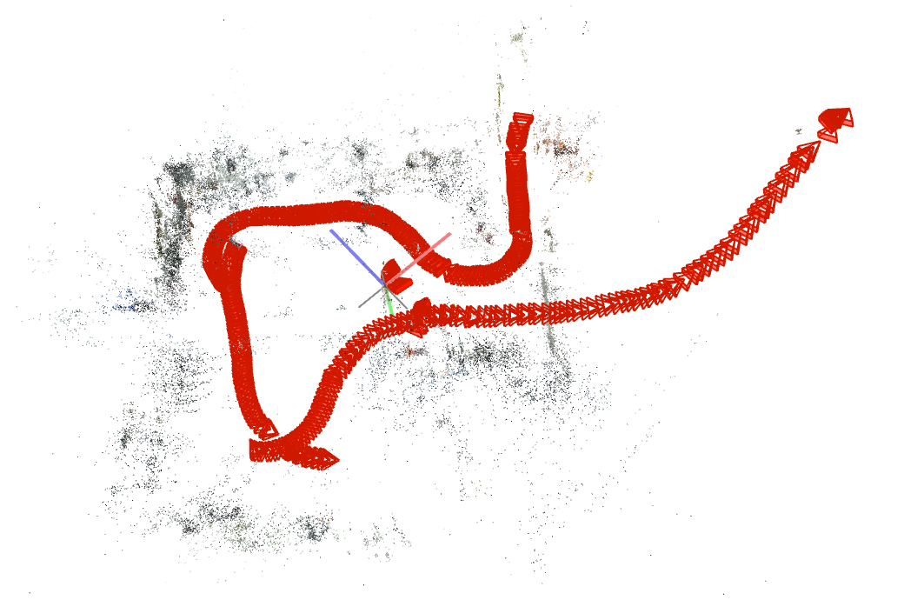
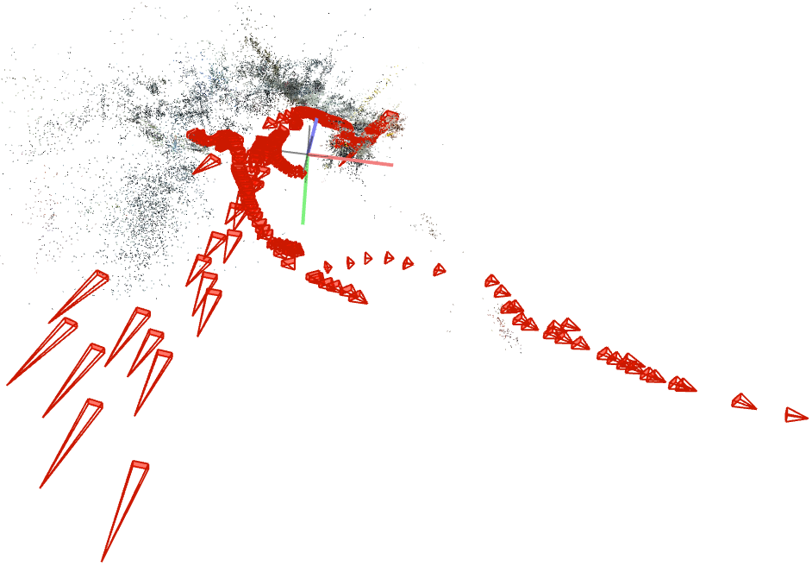
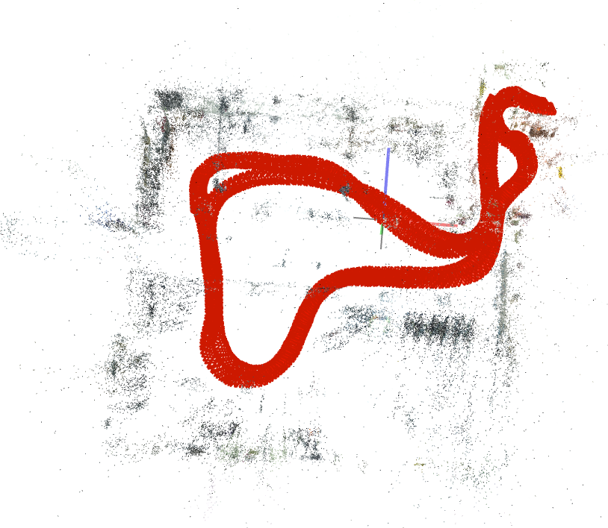
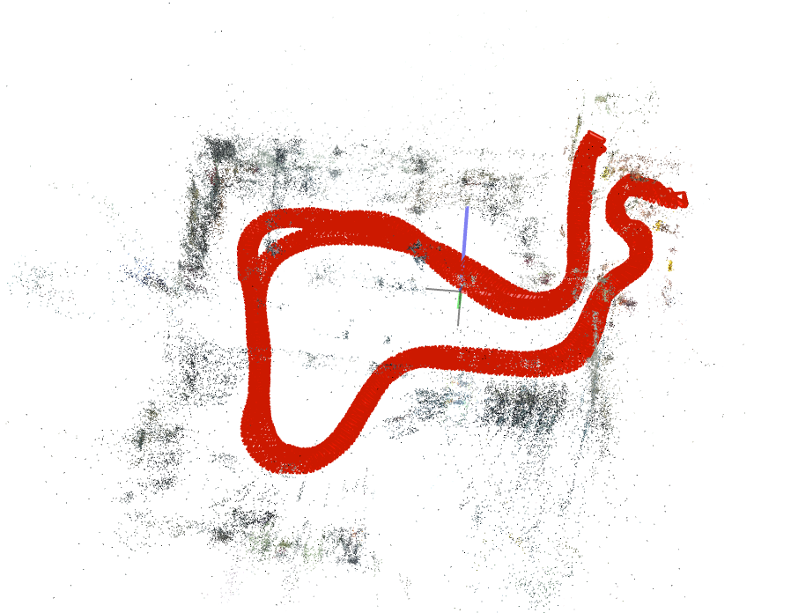
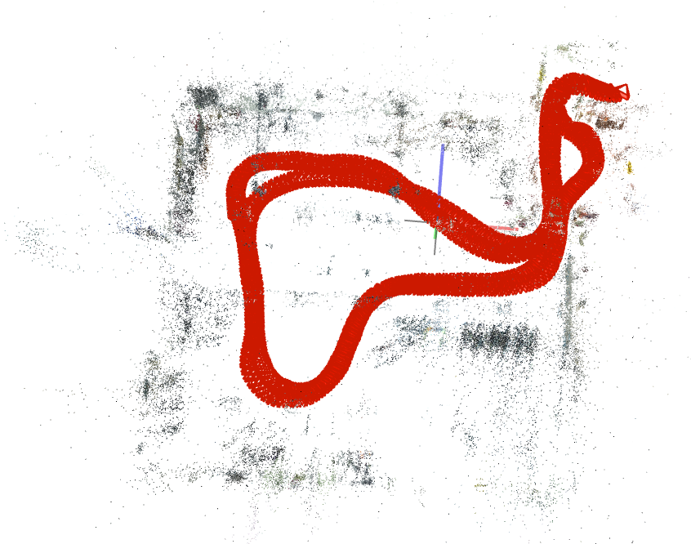
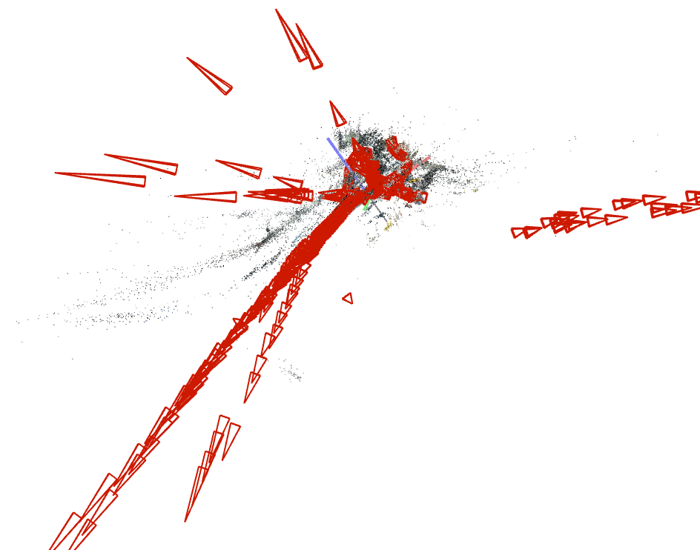





10 FPS 5K
SIMPLE_RADIAL_FISHEYE | SIMPLE_RADIAL | RADIAL | FOV
SINGLE
DOUBLE

Slide 13
LOWERING FPS TEST
5K
5FPS
Colmap spherical camera models
Single room

Slide 14
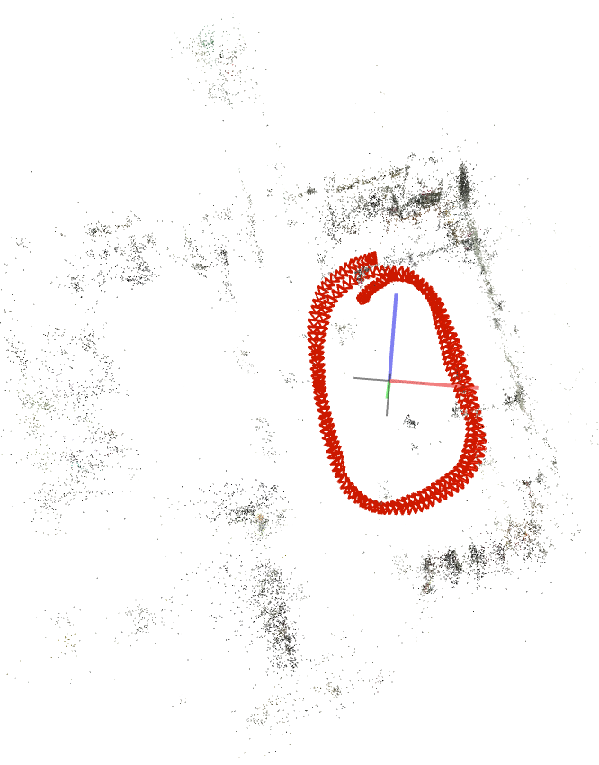
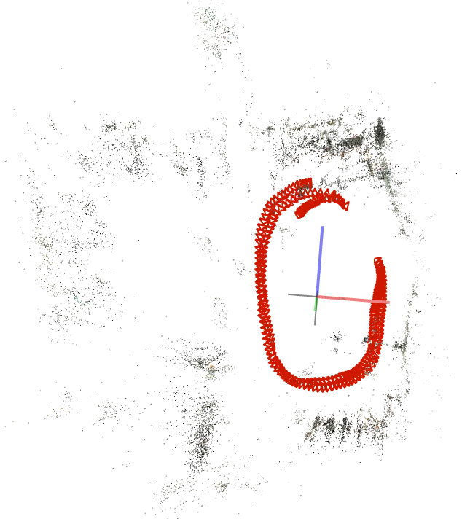
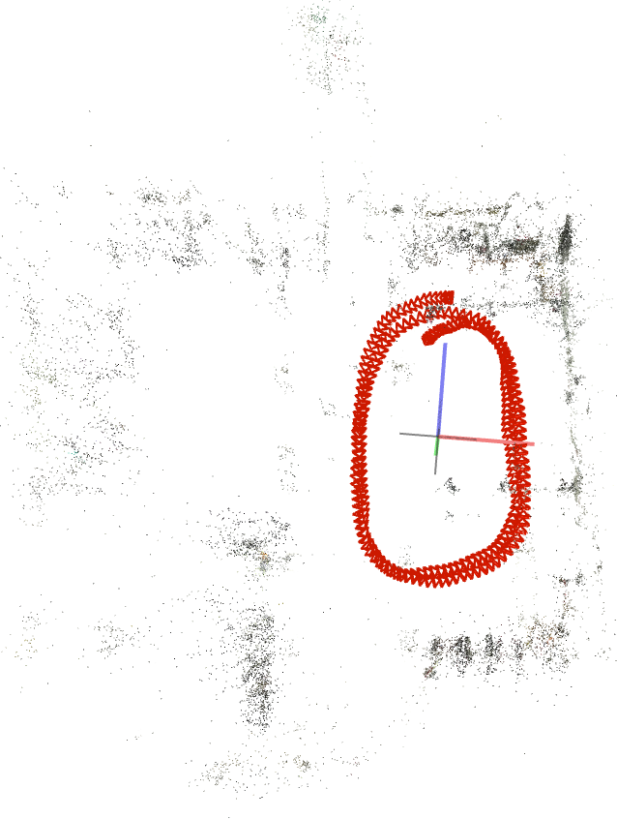
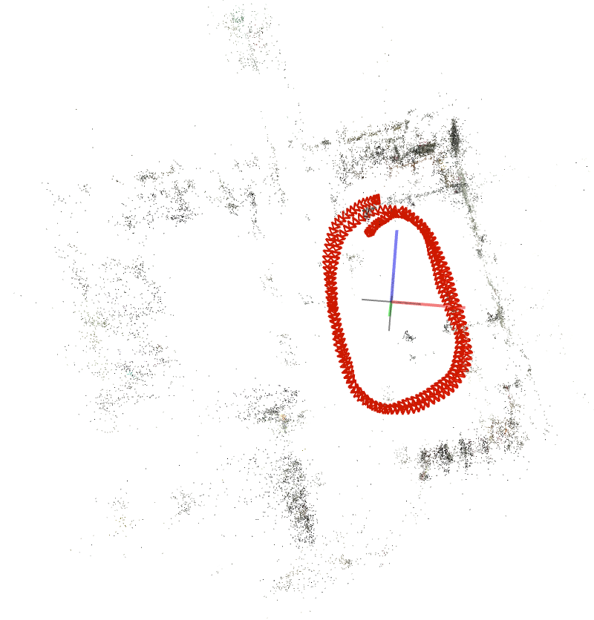
5 FPS 5K (RUNTIME ~ 5 [minutes])
SIMPLE_RADIAL_FISHEYE | SIMPLE_RADIAL | RADIAL | FOV
10 FPS
5 FPS

Slide 15
CONCLUSION
From all the previous experiments run, we can now conclude that the dominant parameters for sfm to yield a correct sparse model and estimate camera poses are :
Frame size
Camera model
5 FPS yields to similar sparse model than 10 FPS
Next : Improve pre process of data (calibration and stabilization)

